Slide 1
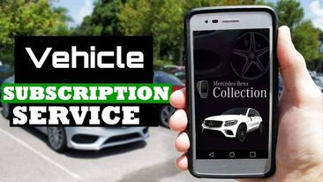
Travel Design
The better way to enjoy your journey
Team Members:
1. Md. Abu Ammar - 1821944642
2. Sadia Afrin Tamanna- 1812030042
3. Tamalika Bakshi- 1812469042

Slide 2
What is vehicle subscription service?
Vehicle subscription services are services that allow subcribers to pay a monthly subscription fee to use a variety of vehicles without having to actually own any of them. It’s similar to the idea of leasing a car, except usually subscription-service users aren’t limited to just one particular vehicle, and many services also cover costs like insurance and maintenance. Vehicles are usually delivered to subscribers and can be kept for a set period of time, or indefinitely, depending on the service.

Slide 3
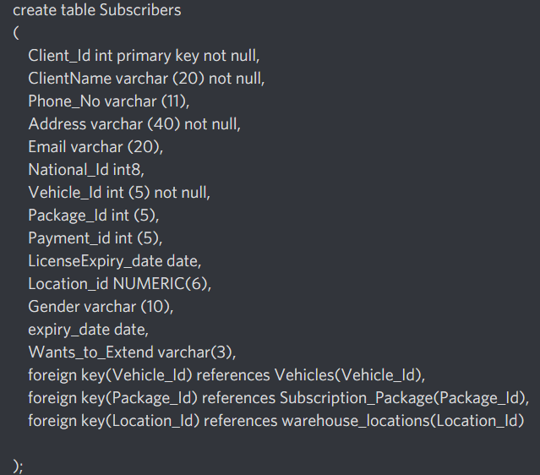
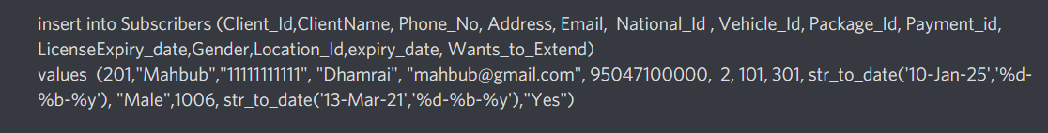
Create table and data population into table : Required Tables:1.subscribers 2.vehicles 3.employees 4.warehouse Locations 5.insurance 6.exporters 7.subscription_package 8.emp_salary 9.emp_salary_log 10.payment_log

Slide 4
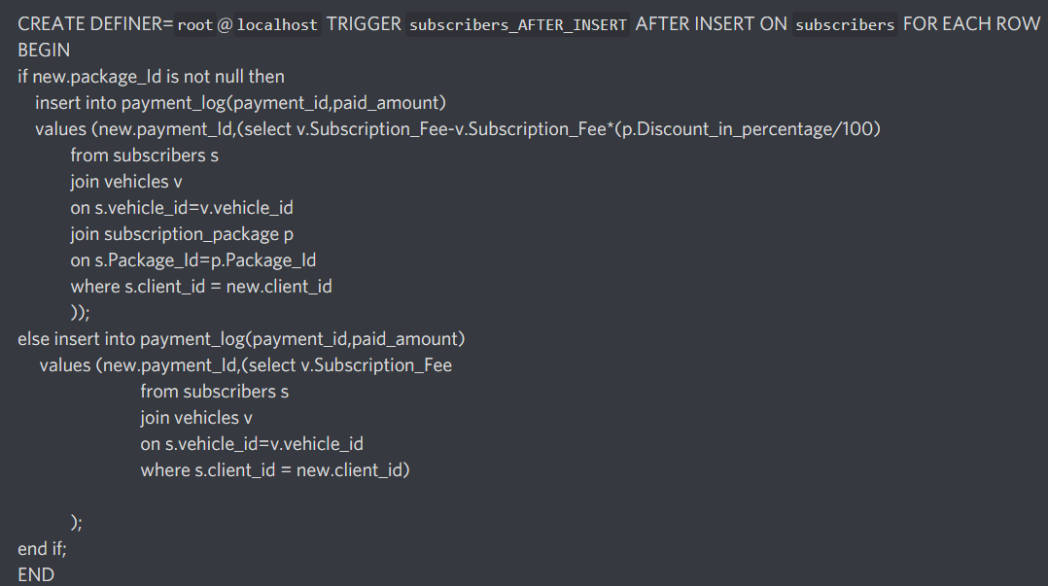
In this project our goals are : 1) When any subscriber subscribed any vehicle his transaction info will be automatically recorded by using trigger .

Slide 5
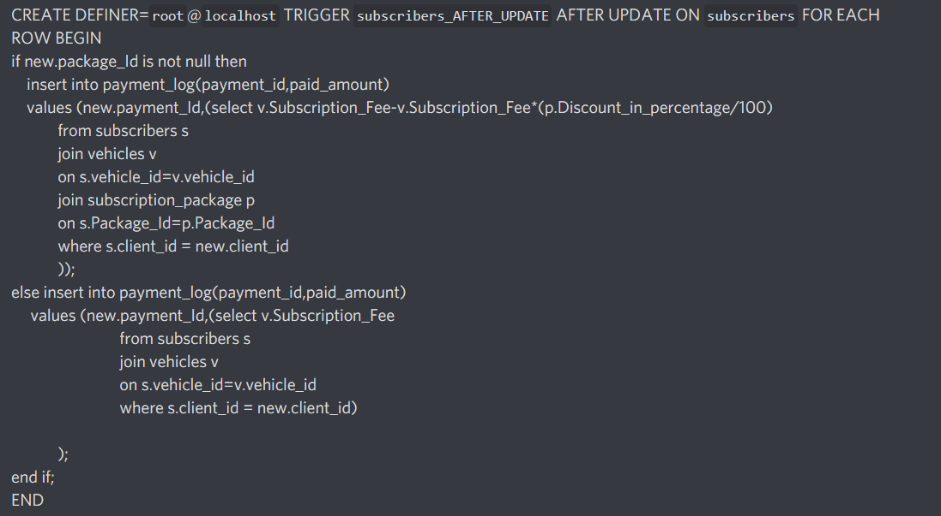
2) When any customer renew his/her subscription period then their new transaction will also be recorded automatically by after updating trigger.

Slide 6
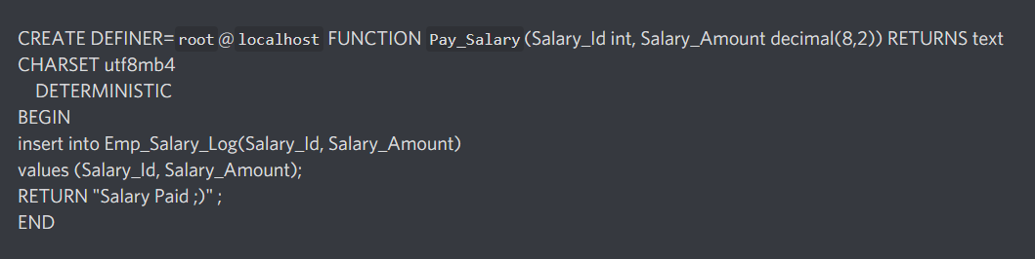
3)We can give the salary to any of our employee by the following function and its also will be automatically recorded in our database:

Slide 7
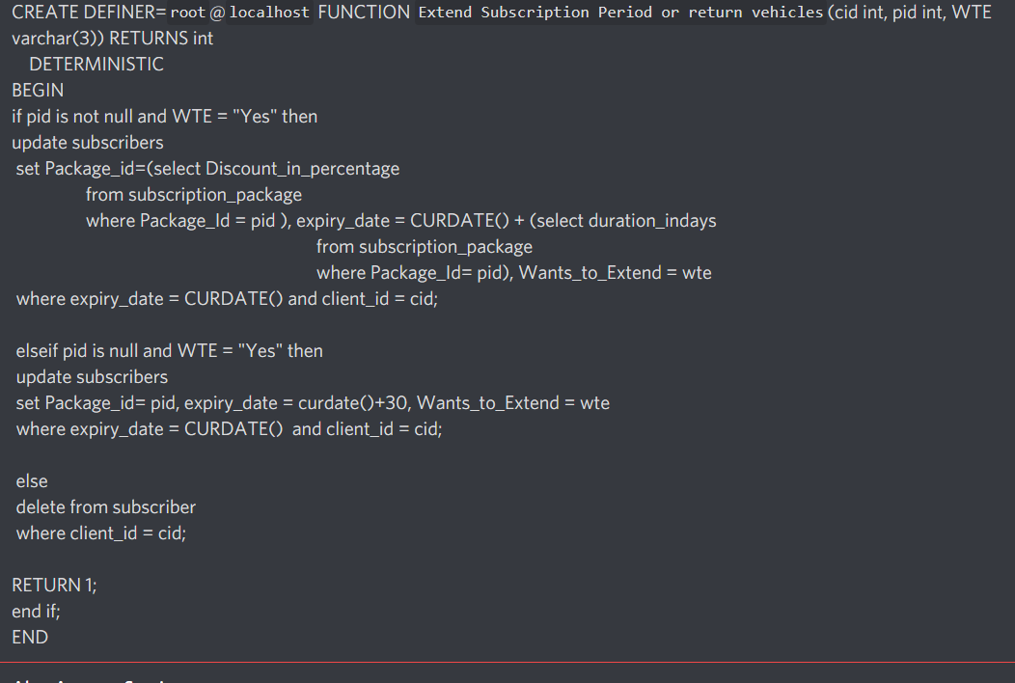
3) If client wants to extend the subscription period with discount packages using function .

Slide 8
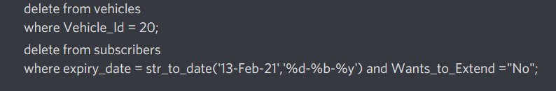

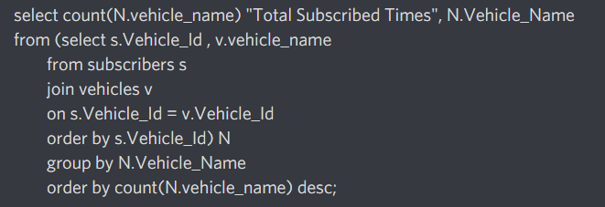
-- Delete test -- If a vehicle is no longer available for our campany. ---If subscription period ends. -- updating subscription fees -- Most demanding Cars

Slide 9
Conclusion : The process of creating a design of project for a database that will support the enterprise operations and objectives. In this project, our goal was to implement such a service by DBMS that we can provide their desired vehicles of customers for a certain period so that they can easily afford a desired vehicle and enjoy their rides. So, we created this “vehicle subscription service” by DBMS in MySQL.

Slide 10

Thank you
Any question ??

